Slide 1
UI Possible Screens

Slide 2
Buccaneer title and logo
This is the first buccaneer requirement, 'it will prompt the users for the name of each of the four players'.

Slide 3
Buccaneer
Image of pirates
Image of pirates
Image of pirates
Image of pirates
Player 1
Player 2
Player 3
Player 4
Enter name
Enter name
Enter name
Enter name
Continue
This is the first buccaneer requirement, 'it will prompt the users for the name of each of the four players'.

Slide 4

Image of pirates
Player Name
The requirements state that the players each must be randomly assigned a port.

Slide 5
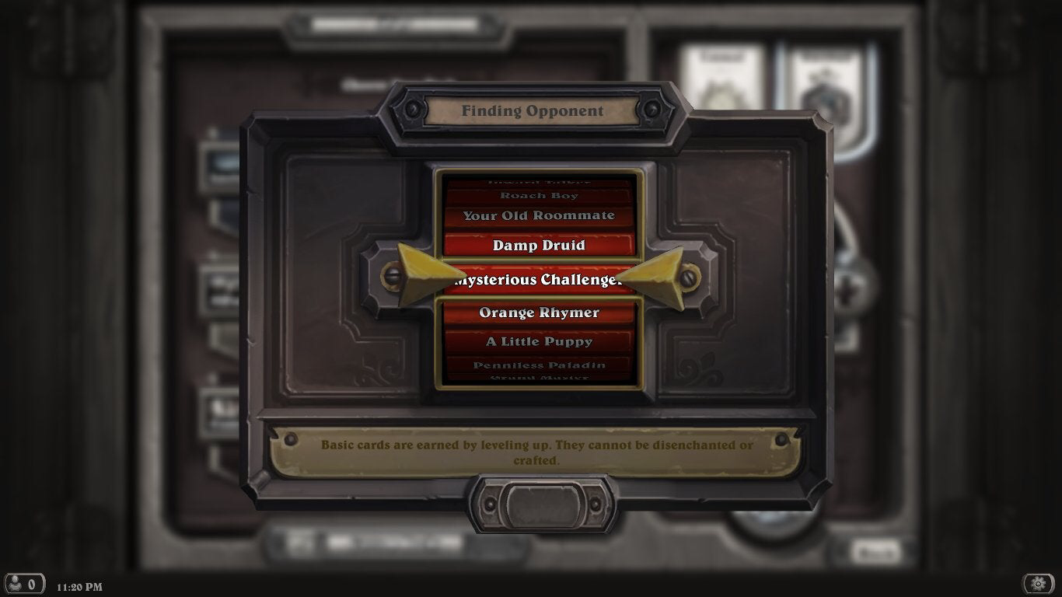

Slide 6
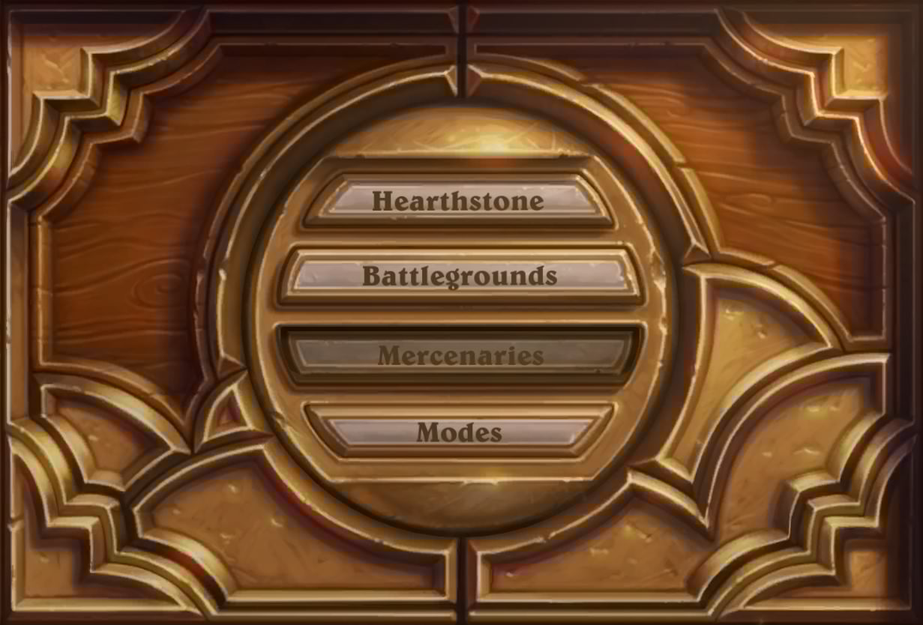

Slide 7












The London in yellow indicates that, that’s where the current players port is

Slide 8























Slide 9



The London in yellow indicates that, that’s where the current players port is

Slide 10










So as the grid is quite small I think the UI should be very concealed and can be shown when the user wants to see it. For example to see the crew cards there will be a pull tab at the bottom of the screen like shown

